Slide 1

Basic Details of the Team and Problem Statement
Ministry/Organization Name/Student Innovation: Ministry of power
PS Code: SIH1300
Problem Statement Title: Automated Public Lighting
Team Name: Bright6
Team Leader Name: Ganesh G
Institute Code (AISHE): UO459
Institute Name: Karpagam College of Engineering
Theme Name: Smart Automation

Slide 2
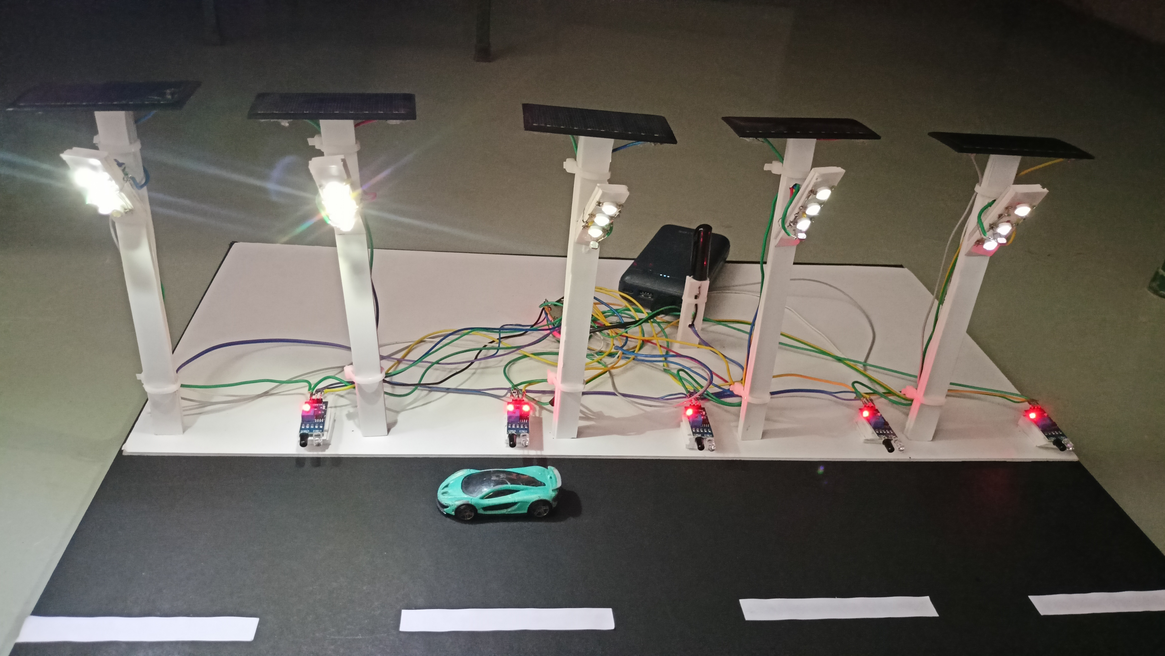
Idea/Approach Details
Describe your idea/Solution/Prototype here:
In our approach we came up with an Intelligent light controller which automatically set the light on/off using sensor based upon weather condition , daytime and nighttime.
Also, the adjustments of brightness are done by detecting the object movements. If object movement is detected, the brightness of light enhances otherwise depletes. Therefore it helps to reduce electricity consumption.
Fault detection, if any lamp is not working, then it should be informed to the nearby EB office by using IOT.
Intelligent lighting solution will minimize disruption in service , allow prompt servicing and centralized governance and orchestration of street lights that are spread across cities.
Describe your Technology stack here:
Data Collection: Getting the information from the sensors and also getting current condition of the lamp.
Data Processing: Using collected information and makes the decision.
Data Storing : Storing the lamp condition and
usage of electricity in Database.

Slide 3
Idea/Approach Details
Describe your Use Cases here
To make safer environment : Remote monitoring helps to monitor the health of lights through smart web based application.
Autonomous system to turn ON/OFF the switches Manage the street lights by controlling each one individually from the common center ,intensity of the lights and turning them on/off.
Reducing light pollution : Turning off lights that reduce illumination without affecting visibility especially in empty streets at night . This will also lessen the likelihood of usage.
Remote switching: Measure consumption per usage of light will help to identify the faulty bulbs.
Civic authorities will benefit from the ability to implement and manage street lighting in a much more efficient and cost effective way.
Describe your Dependencies
LIGHT SENSOR :Based on weather conditions light sensor will determine the intensity of light and provide light according to the light intensity and another light sensor to check whether the light is glowing or not.
IR SENSOR: To check the object movement .
If any movement is detected light enhances and
otherwise depletes.
IOT : If light sensor detects any fault in the light or if the light is not glowing the IOT will send the alert messages to the EB office in the corresponding zone.

Slide 4
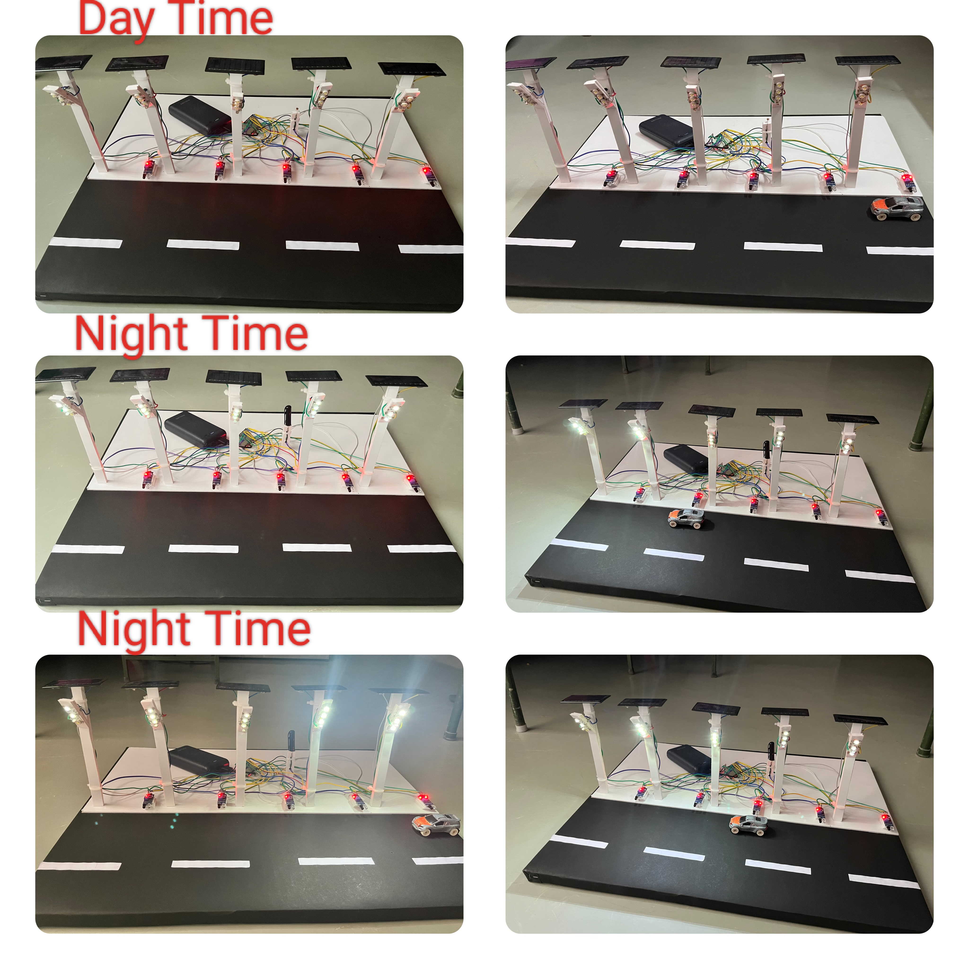
Mechanism
Yes
Night or cloudy
condition
No
Yes
m
Detect
movement
No
Light turns off
Brightness enhances
Brightness
depletes
Information is sent to nearby EB office by using IOT
If fault detected
Yes

Slide 5
Team Member Details
Team Leader Name: GANESH G Stream CSE Year III
Branch B.E
Team Member 1 Name: JEEVA R Stream CSE Year III
Branch B.E
Team Member 2 Name: SUDHARSHANA V Stream CSE Year III
Branch B.E
Team Member 3 Name: KAVIN K Stream CSE Year III
Branch B.E
Team Member 4 Name: ASWATHI U Stream CSE Year III
Branch B.E
Team Member 5 Name: SURIYA S Stream CSE Year III
Branch B.E
Team Mentor 1 Name: Dr. S. ZULAIKHA BEEVI
Category: Academic Expertise: AI/ML Domain Experience (in years): 18.2

